Slide 1
Changing from TG21 to TG51 in the Department of Radiation Oncology at the University of Michigan
Paule Charland, Lars Ewell and Scott Hadley
Tx Planning Conference - 4/2/03

Slide 2
TG21 => TG51
TG21 - What, When and How
TG51 - What, When and How
TG51 - Photons
TG51 - Electrons
TG51 - TG21 Comparison
TG51 - Clinical Implications

Slide 3
TG21: Protocol for Dose Determination
Published 11/83 by AAPM, 30 pages.
Provides for Dose Uniformity Between Institutions.
Relies on ADCL Calibrated Ion Chamber: ⁶⁰Co in Air.
Good Reference.
No Longer Supported by RPC, Being Phased Out.

Slide 4
Ion Chambers
-
+
~0.5cm
Ionizing Radiation
Electrometer
Air
Center Conductor
Chamber Wall
Electric Field
Radiation ionizes air in chamber leading to charge measurement.

Slide 5
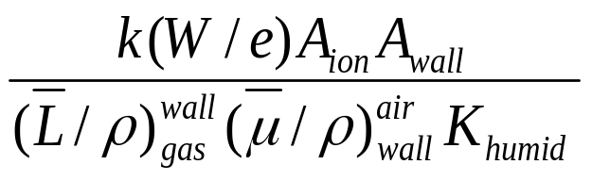
TG21: N_{X} to N_{gas} to cGy/MU
Ion Chamber Returned from ADCL with Exposure Cal Factor - N_{X}
N_{gas} - Dose Delivered to Gas (air) Inside Chamber/Charge.
N_{gas} = N_{X}
Finally, Dose to Phantom (water) is calculated (cGy/MU).

Slide 6
TG51: Newer Protocol for Dose Determination
Published 8/99 by AAPM, 22 pages.
Relies on ADCL Calibrated Ion Chamber: ⁶⁰Co in Water.
Soon Exclusive Protocol Supported by RPC.

Slide 7
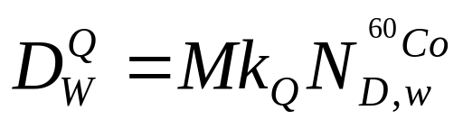
TG51: N_{D,W} to cGy/MU
ADCL Returns Chamber with Absorbed Dose to Water Cal Factor.
Dose to Water at Other Energies Obtained from Quality Conv. Factor.
Two Other Main Differences from TG21 (Later Slides).

Slide 8
TG51: Photons
Bremsstrahlung Target
Flattening Filter
Pb Foil
At High (>10MV) Energies, e⁻ Contamination Can be Significant.
Pb Foil Placed Between Source and Detector Blocks/Controls e⁻

Slide 9
TG51: Electrons
Parallel Plate
Cylindrical
At Low Energies, Ion Chamber Itself Affects Measurements.
Parallel Plate Chambers Perturb Field Less Than Cylindrical.
TG51 Requires Parallel Plate Chambers for E < 6MeV.

Slide 10
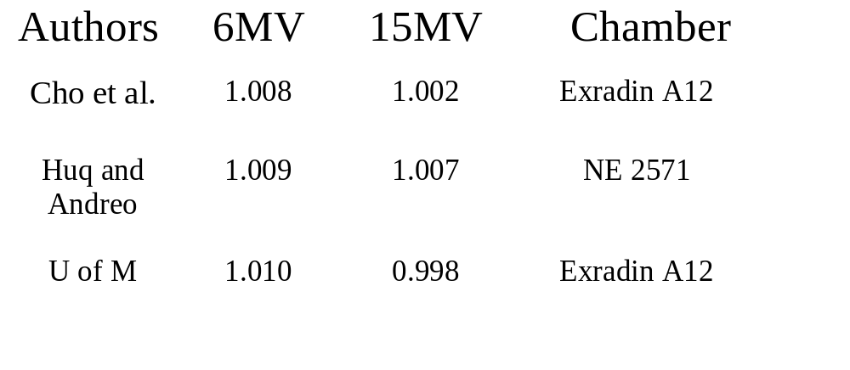
TG51/TG21 Photon Output Ratios and Comparison

Slide 11
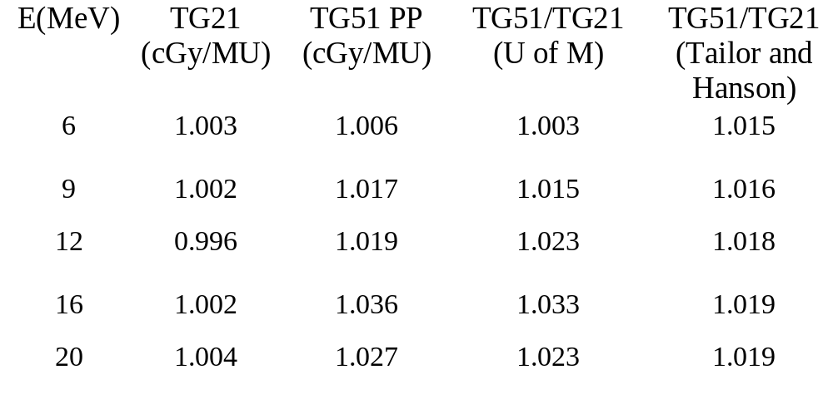
TG51/TG21 Electron Output Ratios

Slide 12

TG51: Clinical Implications
In ~2 Weeks, EX2 Calibration per TG51.
Same Number of MUs Gives < 1.5% Less Dose at 6X.
For Reference, Monthly Tolerance 1.5%, Daily 3%.
Higher Energy e⁻, Up to 3.3% Difference.
EX1, EX3 and 2100CD to Follow Soon.
6/100 Already TG51 Compliant.

